Slide 1













Pia Hildebrandt Software-Development

Slide 2

Pia Hildebrandt Software-Development

Slide 3

Pia Hildebrandt Software-Development

Slide 4

Pia Hildebrandt Software-Development

Slide 5

Pia Hildebrandt Software-Development

Slide 6
Pia Hildebrandt Software-Development

Slide 7

Pia Hildebrandt Software-Development

Slide 8

Pia Hildebrandt Software-Development

Slide 9

Pia Hildebrandt Software-Development

Slide 10

Projekt 1 anskn dlkajlkfjda jöl afds tech: html, CSS

Slide 11
Projekt 1 anskn dlkajlkfjda jöl afds tech: html, CSS

Slide 12
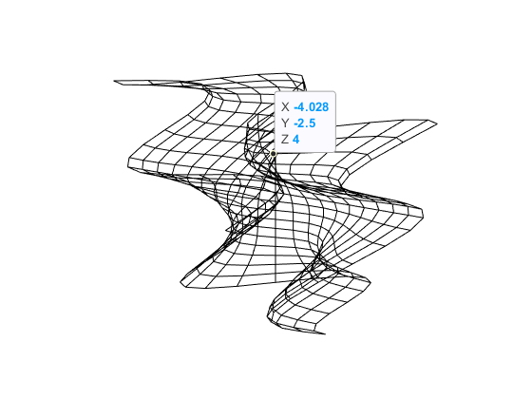
Projekt 1 anskn dlkajlkfjda jöl afds tech: html, CSS

Slide 13
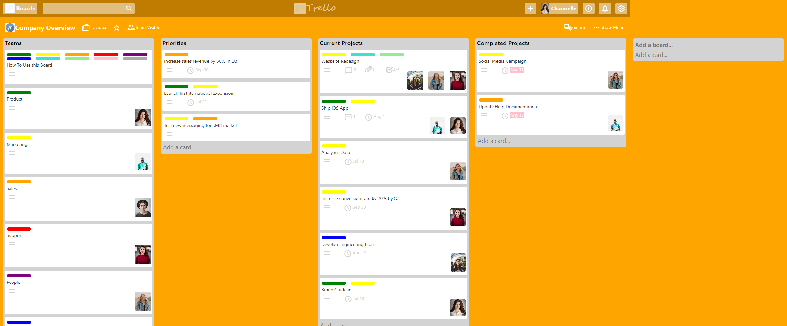
Projekt 2 anskn dlkajlkfjda jöl afds tech: html, CSS

